Slide 1

Public Opinion · Public Policy · Organizations · Campaigns
1987 – Founded in San Diego
1988 – Phonecenters established in Riverside, CA and San Diego
1990 – Phonecenters established in Reno, NV and San Diego
1992 – Predictive dialing installed to double interviewing capacity; CERC calls San Diego Mayor’s race
1993 – "The Edge" newsletter launches
1998 – Qualitative focus groups introduced
2000 – CERC calls San Diego Mayor’s race
2003 – KPBS/Competitive Edge Research Poll and annual Super Bowl poll launched
2004 – CERC calls San Diego Mayor’s race (x2)
2005 – CERC calls San Diego Mayor’s race (x2)
2006 – SDIPR/CERC Opinion Barometer launched; Ballot measures paper presented at AAPOR Conference
2008 – CERC calls San Diego Mayor’s race; Convenes post-election summit @ USD
2009 – Interviewer effects paper presented at AAPOR Conference
2010 – Web-based interviewing and custom panels introduced
2012 – Dial-testing introduced; CERC calls San Diego Mayor’s race (x2)
2013 – CERC calls San Diego Mayor’s race; Business Forecast survey launched
2014 – CERC calls San Diego Mayor’s race
2016 – CERC calls San Diego Mayor’s race
2017 – Phonecenter established in El Paso, TX
2018 – CERC calls CA Governor’s race (x2)
2019 – Ballot measure wording paper presented at AAPOR Conference
2020 – Incumbent viability paper accepted for presentation at AAPOR Conference
2022 – San Diego County Issues Barometer launched
John Nienstedt, MA Political Science: President
Member, American Association for Public Opinion Research
SBA Entrepreneurial Success Award (2000)
Pollster of the year (x7)
Rachel Lawler, MA Political Science: Research Analyst
Member, American Association for Public Opinion Research
Ronald Zavala: Director of Operations
James Iwu: Research Assistant

Slide 2

San Diego County Issues Barometer
Dec. 2022
200,000 leaving San Diego and another 600,000 seriously considering a move
Weather is the calling card, Cost of living is the bane

Slide 3
Summary
Research Objective: 1) Determine interest in leaving San Diego County
2) Understand dynamics of those decisions
Sample Size: n=504
Margin of Sampling Error: ± 4.4%
Confidence Level: 95%
Sample Methodology: Simple random sampling from listed sample
Jurisdiction: San Diego County
Eligibility: Adult residents
Interview Methods: Telephone (including cell phones), e-mail push-to-web, text push-to-web
Field Dates: December 1-6, 2022
Field Facility: Competitive Edge Research, El Paso TX
Project Director: John Nienstedt, Sr.
Research Analyst: Rachel Lawler
Research Assistant: James Iwu

Slide 4
Are we “America’s Finest City”?
San Diego remains a popular tourist destination, but the County’s population has declined
The U.S. Census shows a decrease of 11,183 residents since July 2020, the first contraction in more than a decade
If San Diego’s downward trend continues, expect:
  Demographic shifts
  Further political ramifications
  Slowing economic growth
  Struggle with tax revenue.

Slide 5
The Best Thing about Living in San Diego

Slide 6
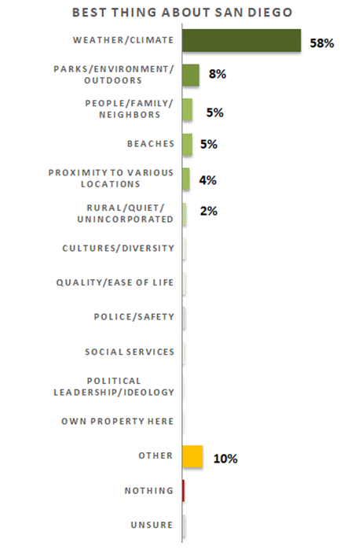

The Weather Is San Diego’s Calling Card
With avg. temps in the mid-70s, it’s natural to find “weather” atop the list
“The climate makes it nice for outdoor activities all year long”
“The weather and year-round outdoor lifestyle with great dining and recreation opportunities”
“We don't have bad storms, tornadoes, or hurricanes”
  Older non-Latinos focus on weather more often, as 82% of non-Latinos 60-plus say it’s what they like most
8% say parks, environment and outdoor amenities are San Diego’s best feature
  Young and middle-aged college graduates mention this more
5% proclaim the people, their family, and neighbors are what’s best
  Asians are 2x as likely to respond this way
Another 5% think the beaches give San Diego its edge
  North coastal residents say this 2x more often
4% focus on the proximity to LA, the border, the mountains or amenities.

Slide 7
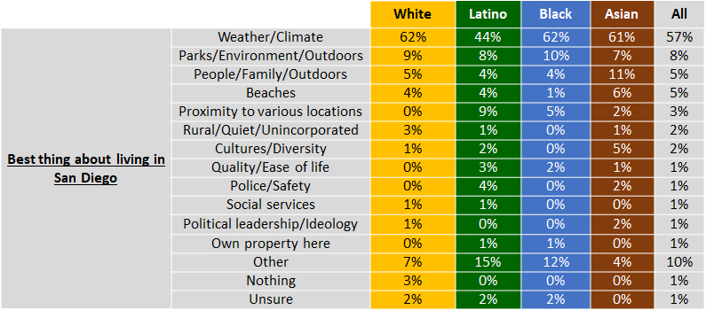
A Closer Look at Our Ethnic Communities
Opinions about San Diego’s best features among Blacks are in-line with others
AAPI residents are more apt to say people/family/neighbors are what’s best
The climate is less prized among Latinos, but being close to amenities is a bigger plus.

Slide 8
The Worst Thing about Living in San Diego

Slide 9
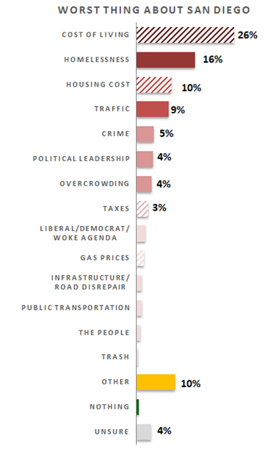
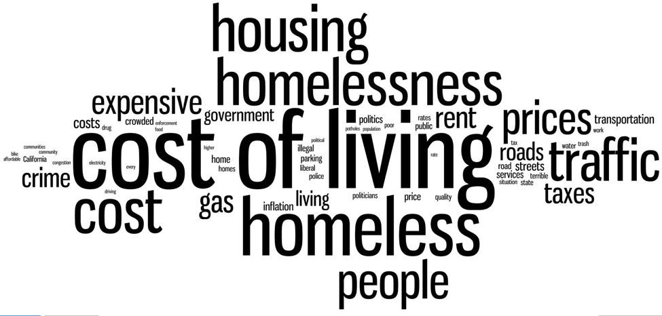
Cost of Living, Homelessness Top the List
26% say the cost of living in San Diego is the worst thing about it
“The cost of living in San Diego is extremely expensive and I don't see the government stepping in and providing anything to ease the expense”
  Non-Latino voters bring up living expenses more often
One-in-six regard the amount of homelessness as the most unpleasant aspect
  Residents south of SR-54 more often say it’s San Diego’s biggest affliction
10% name housing costs and their sense is only wealthy folks can afford San Diego
“Housing isn’t affordable for the average working San Diegan”
Traffic is the biggest pitfall for 9%
  Eastern and north inland suburbs emphasize traffic
5% focus on crime
41% say San Diego’s problem is fiscal.

Slide 10
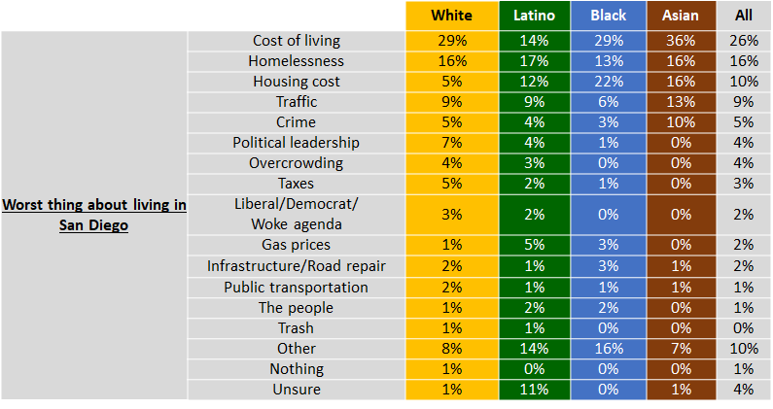
A Closer Look at Our Ethnic Communities
The Black community disproportionately focuses on housing as the worst thing
Latinos are less likely to cite the cost of living as the worst thing
AAPI residents are twice as likely to say crime is San Diego’s worst aspect

Slide 11
Where Might People Move To?

Slide 12
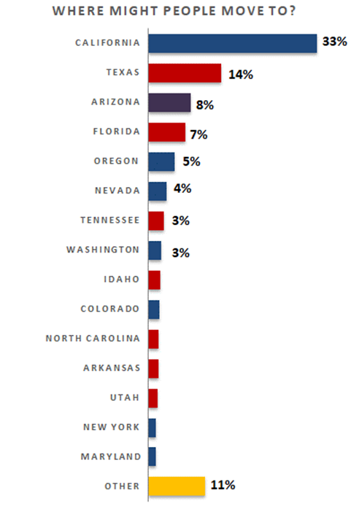
2/3 Would Leave the Golden State
It’s a matter of “voting with their feet”
  90% of those who think the county is on the wrong track would “get the heck out” of California
  Only those OK with things here and unafraid of rising costs would mostly stay
A quarter would land in another Western state
The South also attracts a solid 24%
  It entices people for political reasons, appealing more to non-Democrats
Few would consider relocating to the Midwest (3%) or Northeast (2%)
Texas, Arizona, and Florida are the most popular destinations
Oregon, Nevada, and Tennessee are also attractive.

Slide 13
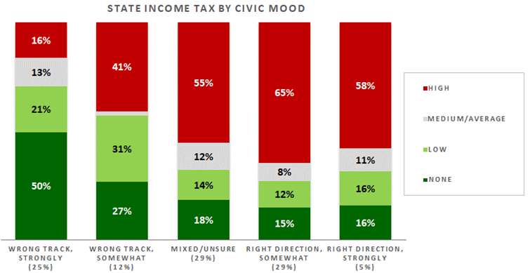
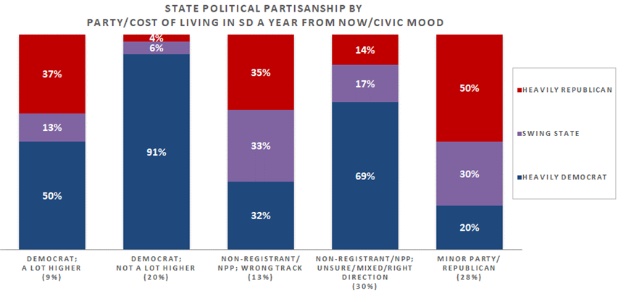
The Pull of Certain Types of States
43% of San Diegans select a state with no or low income tax
  This is mainly driven by a resident’s sense of where San Diego is headed
A similar share pick a high tax state (which includes California)
54% name a blue state, 27% would prefer a red state purple states sound attractive to another 19%
Republicans are partial to red states
Non-partisans and non-voters gravitate somewhat to blue states…
  Unless they think things here going badly
Democrats overwhelmingly pick blue states
  But when a Democrat thinks the cost of living will rise a lot, half won’t move to a blue state.

Slide 14
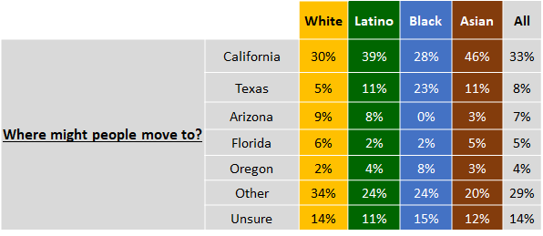
A Closer Look at Our Ethnic Communities
Blacks are more partial to Texas
The AAPI community leans towards “blue” states, including California
Relocation choices among the Latino community align with those of the population at-large.

Slide 15
Moving Out of San Diego County?

Slide 16
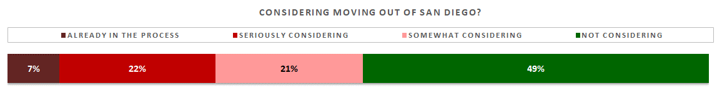
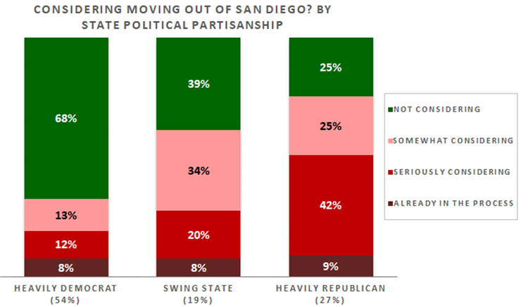
Roughly 200,000 are Leaving
7% are already in the process of exiting the county
Another 22% are seriously considering moving out
If they all acted on that impulse, San Diego would drop about 600,000 more residents!
Such a massive population loss would spell trouble for the region
Another 21% are toying with the idea of moving out
Most residents who think a red state is enticing are either seriously considering moving or already in the process
The red state tug is very real and one reason the local Republican electorate is withering
Conversely, two-thirds who would move to a blue state (heavily Democrat) are not thinking about leaving San Diego
Another factor hardships caused by the cost of living
Traffic is another negative pushing people out.

Slide 17
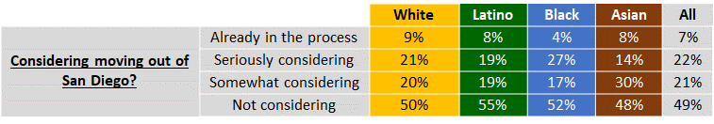
A Closer Look at Our Ethnic Communities
When it comes to making a move out of the county, we’re all about the same.

Slide 18
Why are People Considering Moving?

Slide 19
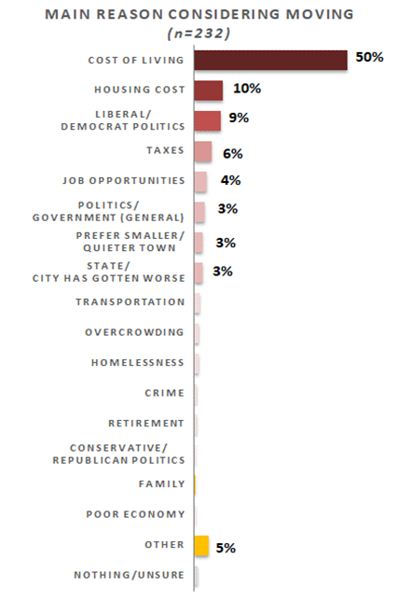
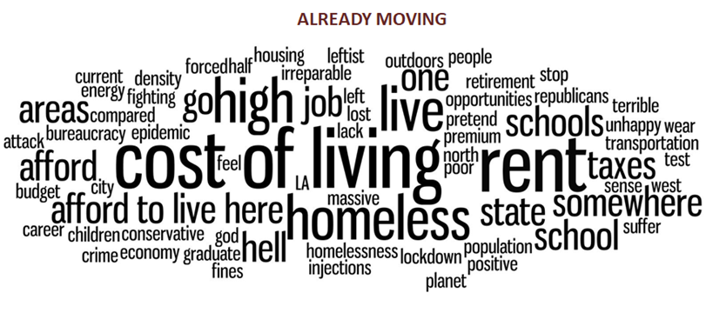
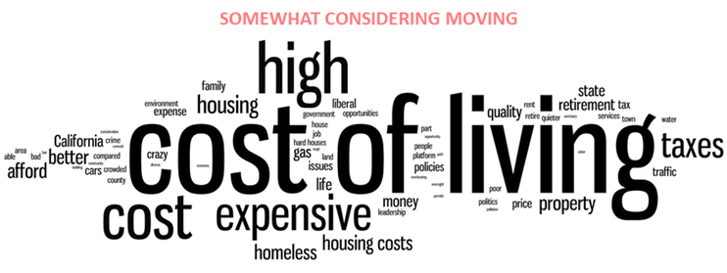
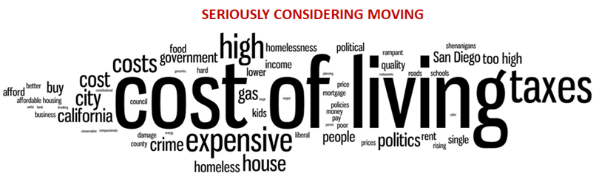
When Asked, Cost of Living is Pushing San Diegans Out
Only 9% cite a personal reason (school, work, or family issues)
90% mention things like cost of living, home prices, or politics as the impetus
Half mention cost of living alone; it’s a massive force
“Everything is expensive! Daycare, gas, food, groceries, I can't keep doing this all day”
One senior citizen soberly commented, “the high cost of living, food, gas, and poor healthcare system. I would prefer to live where life is less stressful. The worrying about money takes the joy out of living here”
Another 10% point to high housing costs
  Young women mention this more often.

Slide 20
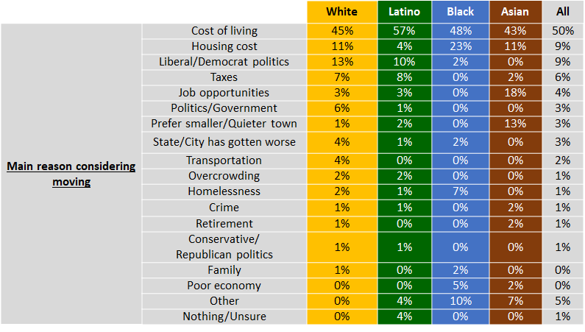
A Closer Look at Our Ethnic Communities
Exiting African Americans focus more often on housing costs
Asian residents point to personal reasons more often than others do
Latinos focus less on housing as their reason for leaving.

Slide 21
Why are People Staying?

Slide 22
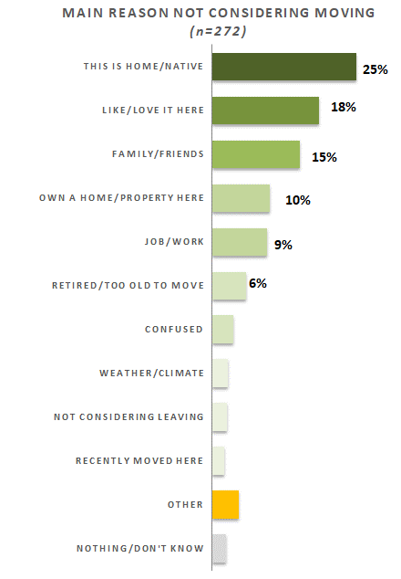
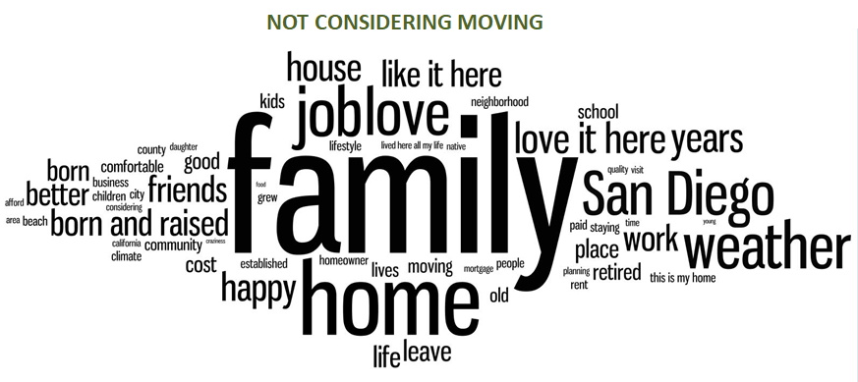
Most Stay Put for Personal Reasons
56% who are not moving are staying put for personal reasons
  Folks who express strong ties to San Diego are hesitant to move, as personal connections keep them rooted here
A quarter won’t budge because they’re natives and/or feel this their home
“This is my hometown; I'm not just going to abandon it! I'm going to try to make it a better place to live for others”
18% are staying put purely because they “love” San Diego
  Lots of seniors talk this way: “I love my city too much” to leave
Nearby family and friends is the reason 15% won’t move
  Non-Whites say this 27% of the time
Another 10% are remaining here because they own property.

Slide 23
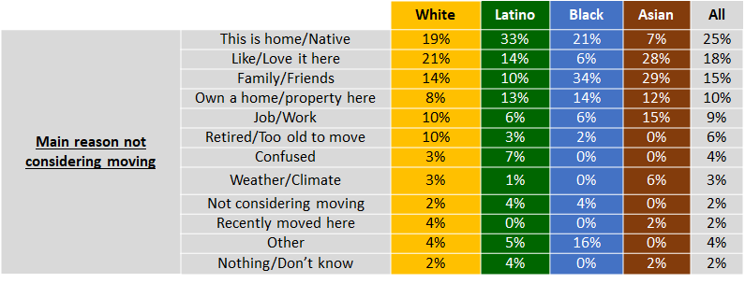
A Closer Look at Our Ethnic Communities
African Americans less often say they’re staying because they love it here
Latinos are staying because of their deep roots much more often
Asian residents who won’t move often say it’s because they:
  Love San Diego
  Have friends and family nearby
  But seldom say it’s because they’re natives.

Slide 24
Thank You!

Slide 25
Public Opinion · Public Policy · Organizations · Campaigns
1987 – Founded in San Diego
1988 – Phonecenters established in Riverside, CA and San Diego
1990 – Phonecenters established in Reno, NV and San Diego
1992 – Predictive dialing installed to double interviewing capacity; CERC calls San Diego Mayor’s race
1993 – "The Edge" newsletter launches
1998 – Qualitative focus groups introduced
2000 – CERC calls San Diego Mayor’s race
2003 – KPBS/Competitive Edge Research Poll and annual Super Bowl poll launched
2004 – CERC calls San Diego Mayor’s race (x2)
2005 – CERC calls San Diego Mayor’s race (x2)
2006 – SDIPR/CERC Opinion Barometer launched; Ballot measures paper presented at AAPOR Conference
2008 – CERC calls San Diego Mayor’s race; Convenes post-election summit @ USD
2009 – Interviewer effects paper presented at AAPOR Conference
2010 – Web-based interviewing and custom panels introduced
2012 – Dial-testing introduced; CERC calls San Diego Mayor’s race (x2)
2013 – CERC calls San Diego Mayor’s race; Business Forecast survey launched
2014 – CERC calls San Diego Mayor’s race
2016 – CERC calls San Diego Mayor’s race
2017 – Phonecenter established in El Paso, TX
2018 – CERC calls CA Governor’s race (x2)
2019 – Ballot measure wording paper presented at AAPOR Conference
2020 – Incumbent viability paper accepted for presentation at AAPOR Conference
2022 – San Diego County Issues Barometer launched
John Nienstedt, MA Political Science: President
Member, American Association for Public Opinion Research
SBA Entrepreneurial Success Award (2000)
Pollster of the year (x7)
Rachel Lawler, MA Political Science: Research Analyst
Member, American Association for Public Opinion Research
Ronald Zavala: Director of Operations
James Iwu: Research Assistant

