Slide 1

Public Opinion · Public Policy · Organizations · Campaigns
1987 – Founded in San Diego
1988 – Phonecenters established in Riverside, CA and San Diego
1990 – Phonecenters established in Reno, NV and San Diego
1992 – Predictive dialing installed to double interviewing capacity; CERC calls San Diego Mayor’s race
1993 – "The Edge" newsletter launches
1998 – Qualitative focus groups introduced
2000 – CERC calls San Diego Mayor’s race
2003 – KPBS/Competitive Edge Research Poll and annual Super Bowl poll launched
2004 – CERC calls San Diego Mayor’s race (x2)
2005 – CERC calls San Diego Mayor’s race (x2)
2006 – SDIPR/CERC Opinion Barometer launched; Ballot measures paper presented at AAPOR Conference
2008 – CERC calls San Diego Mayor’s race; Convenes post-election summit @ USD
2009 – Interviewer effects paper presented at AAPOR Conference
2010 – Web-based interviewing and custom panels introduced
2012 – Dial-testing introduced; CERC calls San Diego Mayor’s race (x2)
2013 – CERC calls San Diego Mayor’s race; Business Forecast survey launched
2014 – CERC calls San Diego Mayor’s race
2016 – CERC calls San Diego Mayor’s race
2017 – Phonecenter established in El Paso, TX
2018 – CERC calls CA Governor’s race (x2)
2019 – Ballot measure wording paper presented at AAPOR Conference
2020 – Incumbent viability paper accepted for presentation at AAPOR Conference
John Nienstedt, MA Political Science: President
Member, American Association for Public Opinion Research
Insights Association
SBA Entrepreneurial Success Award (2000)
Pollster of the year (x7)
Rachel Lawler, MA Political Science: Research Analyst
Member, American Association for Public Opinion Research
Ronald Zavala: Director of Operations
James Iwu: Research Assistant

Slide 2

San Diego County Issues Barometer Nov. 2022
Residents Wary of Northern Baja, as Security Concerns are Up and Visitation is Down
San Diego-Tijuana not Considered a “Mega Region,” But Funding Sewage Treatment is Lauded

Slide 3
Summary
Research Objective: Explore crossborder issues
Sample Size: n=504
Margin of Sampling Error: ± 4.4%
Confidence Level: 95%
Sample Methodology: Simple random sampling from listed sample
Jurisdiction: San Diego County
Eligibility: Adult residents
Interview Methods: Telephone (including cell phones), e-mail push-to-web, text push-to-web
Field Dates: September 2-10, 2022
Field Facility: Competitive Edge Research, El Paso TX
Project Director: John Nienstedt, Sr.
Research Analyst: Rachel Lawler
Research Assistant: James Iwu

Slide 4
Background

Slide 5
San Ysidro is 1 of the World’s Busiest Border Crossings
Before the pandemic, more than 100,000 people crossed the San Diego-Tijuana border every day
Boosters have heralded our area a “mega-region”
However, safety concerns seem endemic
Sewage from Tijuana entering the Pacific Ocean is another challenge
An American proposal to treat the water in Mexico is being considered.

Slide 6
Tijuana and Northern Baja Visitation

Slide 7
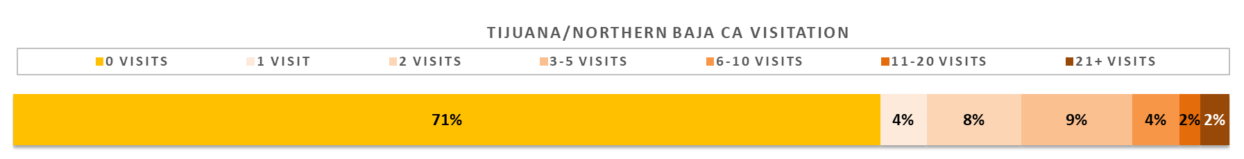
71% Haven’t Visited Tijuana or Northern Baja in the Past Year
COVID-19 shut down nonessential crossings for 20 months, with the border only reopening in November 2021
29% have made at least one trip south of the border
Most visitors are Hispanic
Among non-Hispanics, north coastal residents in cities like Carlsbad or Oceanside are more likely to visit
County residents average 2 visits per year
Rises to 8.4 crossings if the resident lives in the south suburbs.

Slide 8
A Closer Look at Our Ethnic Communities
Slightly more than half of Latinos visited northern Baja during the past 12 months
Visitation is much more frequent
Hispanics who consider themselves not to be multi-racial (generally White Hispanics) visited more regularly than Hispanics who consider themselves to be multi-racial
Among Hispanics, lower levels of Hispanicity lead to more cross-border travel
Slightly fewer African Americans visited
Asian residents are half as likely as the wider population to visit
None in our sample visited > 5 times.
 |  | White | Latino | Black | Asian | All
Tijuana and Northern Baja visitations in past year | 0 | 70% | 48% | 81% | 85% | 72%
 | 1 | 3% | 2% | 3% | 8% | 4%
 | 2 | 10% | 16% | 3% | 3% | 8%
 | 3-5 | 9% | 16% | 6% | 4% | 9%
 | 6-10 | 4% | 8% | 5% | 0% | 4%
 | 11+ | 4% | 10% | 2% | 0% | 4%

Slide 9
Reasons for Visiting

Slide 10
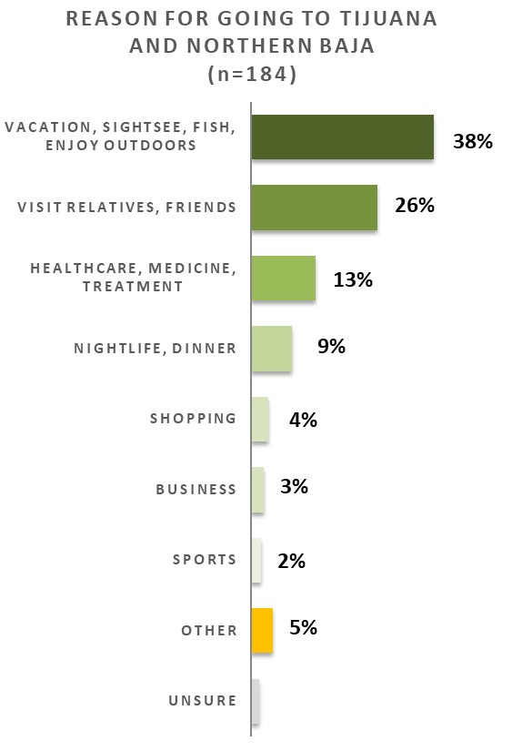
Nearly 4-in-10 Cross for Vacation/Sightseeing
Extremely popular for visitors outside the south suburbs
Only 14% of south suburbanites visit for fun
Vacationers infrequently repeat, averaging only 3.4 visits totaling 1.2 million
26% of visitors cross to visit relatives and friends
60% between SR-54 and SR-94 and 41% south of SR-54 visit loved ones
Only 4% of Baja visitors living north of SR-94 visit friends and family
Having relatives and friends across the border leads to 10.5 visits/year
13% go to access healthcare, medicine, or treatment
More common among women in their late-20s through early-40s
Visitors > 62 also head to Tijuana for medical reasons
Healthcare travelers are the most frequent, averaging 11.3 visits/year
9% mainly go for nightlife/dinner
Increases to 15% for non-Hispanics
Nightlife seekers only make 4.7 trips per year
Just 4% visited for the shopping
But shoppers are frequent repeat customers, averaging 12.8 visits/year.
3.4/1.2m
10.5/2.7m
11.3/1.5m
4.7/0.4m
12.8/0.5m

Slide 11
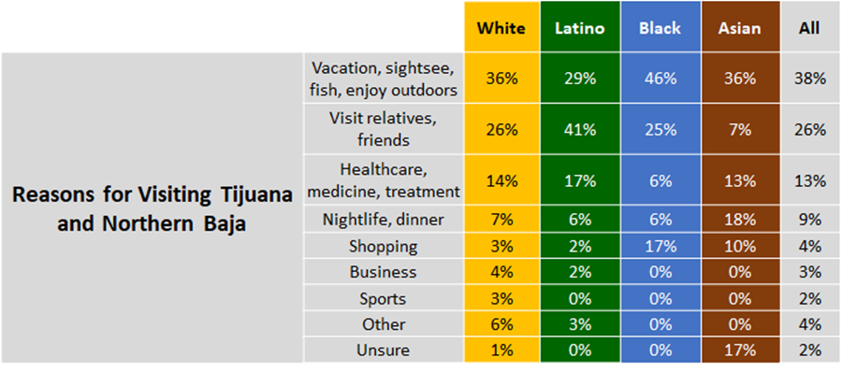
A Closer Look at Our Ethnic Communities
Latinos visit friends and family in Tijuana/Baja much more often.

Slide 12
Reasons for Not Visiting

Slide 13
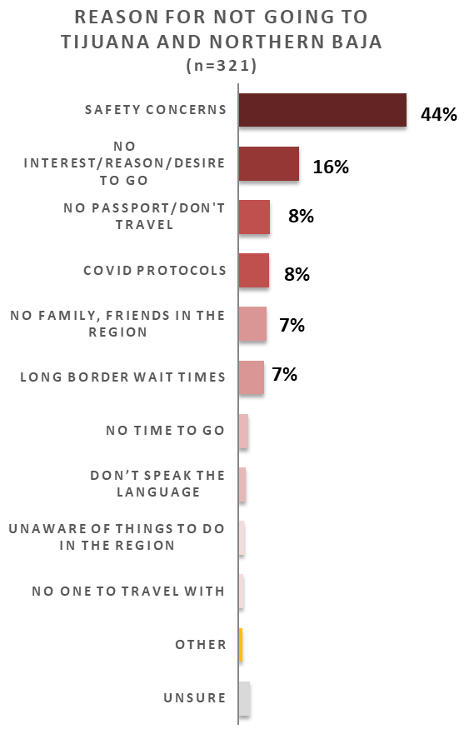
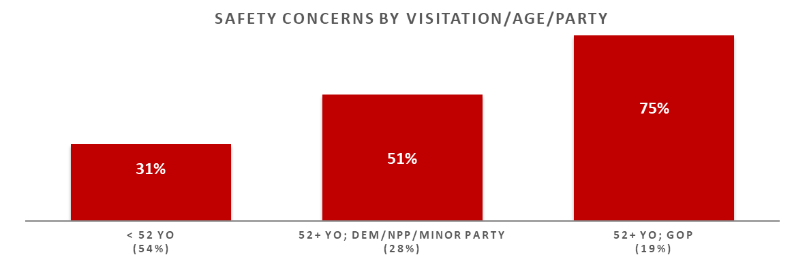
Safety Concerns Easily Top the List
44% cite this, dwarfing all other rationales
Safety concerns increase with age and are politically tinged
Republican non-visitors > 51 are the most worried about their safety
Even half of non-Republicans 52+ express safety concerns
Security fears are less of a barrier for younger residents, with only 14% < 29 avoiding for safety reasons
16% haven’t visited because they have no interest or desire to go
30% of non-Whites say it’s the main reason
COVID protocols (8%), no friends/family (7%), and wait times (7%) are other significant barriers.

Slide 14
A Closer Look at Our Ethnic Communities
The Black community sees long border wait times as a reason for not visiting more than other ethnic groups
AAPI residents more frequently have no interest or desire to visit
Latinos very rarely to point to not having friends or family in the region.
 |  | White | Latino | Black | Asian | All
Reasons for Not Visiting Tijuana and Northern Baja | Safety concerns | 48% | 38% | 38% | 42% | 44%
 | No interest/reason/desire to go | 8% | 19% | 12% | 25% | 16%
 | No passport/Don't travel | 11% | 10% | 1% | 3% | 8%
 | COVID protocols | 9% | 10% | 8% | 13% | 8%
 | No family, friends in the region | 8% | 1% | 1% | 8% | 7%
 | Long border wait times | 7% | 7% | 20% | 2% | 7%
 | No time to go | 1% | 7% | 7% | 1% | 2%
 | Don’t speak the language | 2% | 0% | 0% | 3% | 2%
 | Unaware of things to do in the region | 1% | 0% | 0% | 0% | 1%
 | No one to travel with | 0% | 40% | 4% | 0% | 1%
 | Other | 1% | 0% | 3% | 2% | 1%
 | Unsure | 4% | 4% | 4% | 0% | 3%

Slide 15
Impressions of Northern Baja

Slide 16
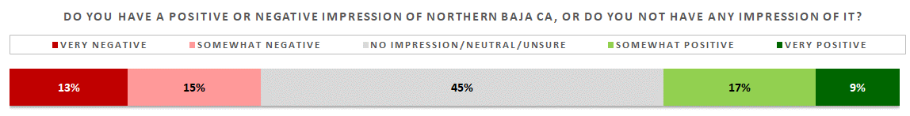
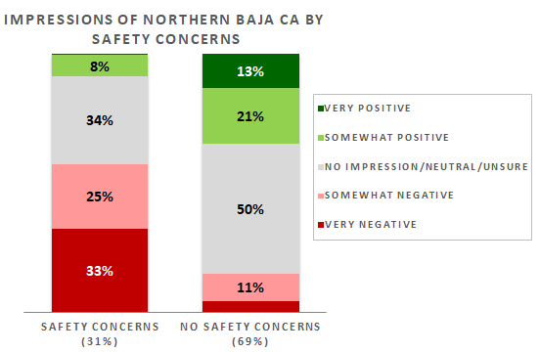
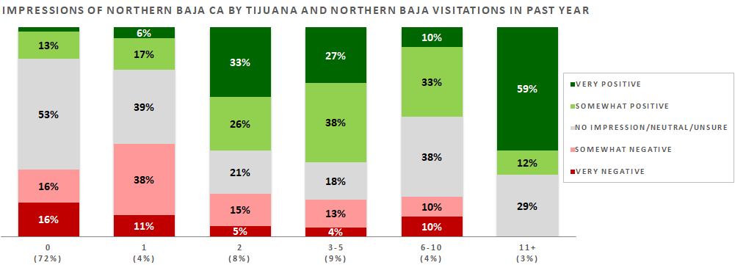
A Large Minority Draw a Blank
Despite being geographical neighbors, 45% have no impression or a neutral impression of northern Baja
And the region has as many fans (26%) as critics (28%)
Views largely come down to the safety issue and visitation
Those who don’t visit specifically because they’re concerned about safety savage the area
Most non-visitors don’t know the area
One-timers are negative
But multiple visits improve opinions.

Slide 17
A Closer Look at Our Ethnic Communities
Most Blacks have no impression of northern Baja
Most AAPI residents have no impression
What impression there are are negative
None in our sample voiced very positive views of the region
Latinos frequently hold more positive views
 |  | White | Latino | Black | Asian | All
Impression of Northern Baja California | No Impression | 34% | 37% | 69% | 62% | 40%
 | Very negative | 14% | 10% | 1% | 12% | 13%
 | Somewhat negative | 17% | 10% | 8% | 18% | 15%
 | Neutral/Unsure | 6% | 4% | 4% | 2% | 5%
 | Somewhat positive | 18% | 18% | 10% | 5% | 17%
 | Very positive | 11% | 20% | 7% | 0% | 9%
overall and are twice as likely to have a very positive opinion
Despite visiting less frequently, Hispanics who consider themselves multi-racial like the area more often than White Hispanics.

Slide 18
Are San Diego and Tijuana a Mega-Region?

Slide 19
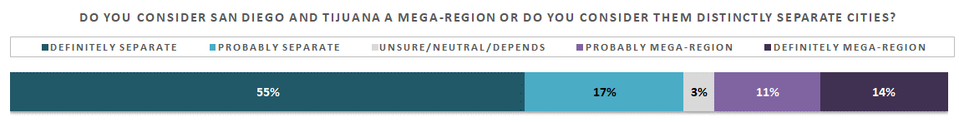
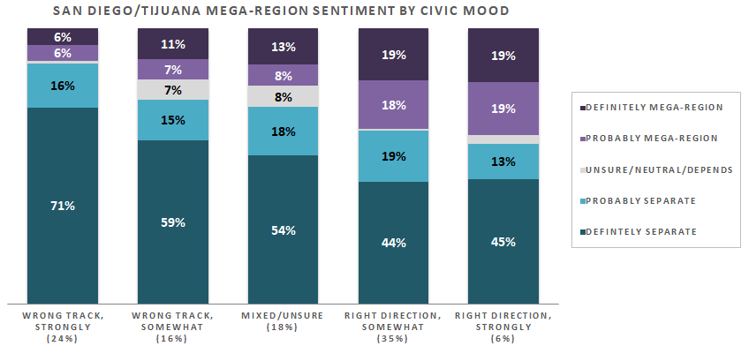
No, The Cities are Separate
Business boosters continue to pitch the two metropolises as a “mega-region”
However, most San Diego residents definitely view the two as distinct cities
San Diego is hugely influenced by Latino culture, but residents generally view the two cities as independent each other.
Upbeat residents are less likely to discount the "mega-region" concept
But even most of them aren’t buying it
Republicans are largely united in their belief that the two border cities are separate
Nonpartisans, minor party voters, non-registrants generally agree
However, > one-third of Democrats believe the cities constitute a mega-region.

Slide 20
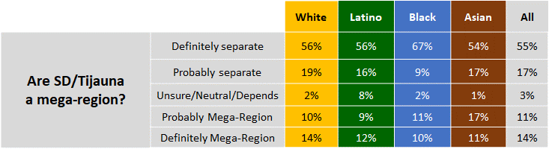
A Closer Look at Our Ethnic Communities
The three communities don’t see San Diego and Tijuana as a mega-region
However, 43% of multi-racial Hispanics do see it that way
On the other hand, fewer White Hispanics agree with the mega-region concept.

Slide 21
Funding Wastewater Treatment Facilities

Slide 22
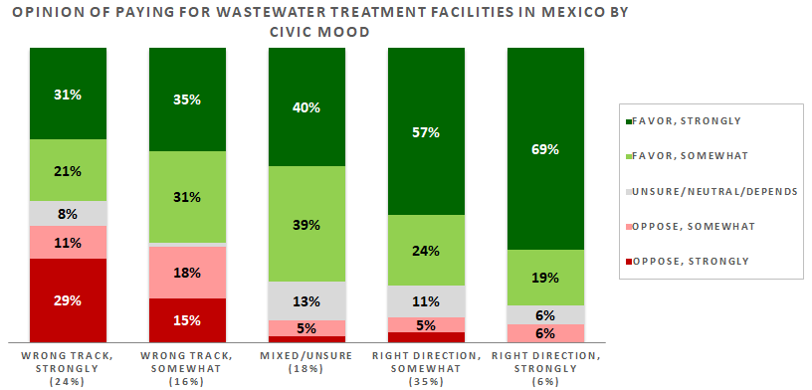
Most Support Funding Sewage Treatment in Mexico
San Diegans reject the “mega-region” concept but 72% want the US to pay for treatment plants located across the border
OPINION OF PAYING FOR WASTEWATER TREATMENT FACILITIES IN MEXICO
Opinions are unrelated to feelings about northern Baja or even how often someone visits the area
This is more about tapping San Diegan’s pride in their beaches, which are a major tourism driver
Residents who feel good about the county's direction are very gung-ho about the project
But the widespread support from less positive residents cements this as a popular endeavor
Unhappy residents are much less in favor, but even most them are supportive
Support will soften – but not evaporate -- if things turn sour, as in a recession.

Slide 23
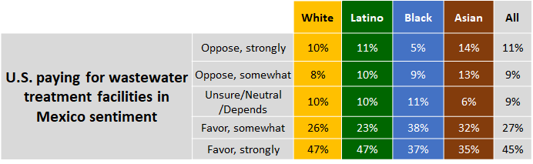
A Closer Look at Our Ethnic Communities
There are no differences when it comes to whether to fund the water treatment project.

Slide 24
Thank You!

Slide 25
Public Opinion · Public Policy · Organizations · Campaigns
1987 – Founded in San Diego
1988 – Phonecenters established in Riverside, CA and San Diego
1990 – Phonecenters established in Reno, NV and San Diego
1992 – Predictive dialing installed to double interviewing capacity; CERC calls San Diego Mayor’s race
1993 – "The Edge" newsletter launches
1998 – Qualitative focus groups introduced
2000 – CERC calls San Diego Mayor’s race
2003 – KPBS/Competitive Edge Research Poll and annual Super Bowl poll launched
2004 – CERC calls San Diego Mayor’s race (x2)
2005 – CERC calls San Diego Mayor’s race (x2)
2006 – SDIPR/CERC Opinion Barometer launched; Ballot measures paper presented at AAPOR Conference
2008 – CERC calls San Diego Mayor’s race; Convenes post-election summit @ USD
2009 – Interviewer effects paper presented at AAPOR Conference
2010 – Web-based interviewing and custom panels introduced
2012 – Dial-testing introduced; CERC calls San Diego Mayor’s race (x2)
2013 – CERC calls San Diego Mayor’s race; Business Forecast survey launched
2014 – CERC calls San Diego Mayor’s race
2016 – CERC calls San Diego Mayor’s race
2017 – Phonecenter established in El Paso, TX
2018 – CERC calls CA Governor’s race (x2)
2019 – Ballot measure wording paper presented at AAPOR Conference
2020 – Incumbent viability paper accepted for presentation at AAPOR Conference
John Nienstedt, MA Political Science: President
Member, American Association for Public Opinion Research
Insights Association
SBA Entrepreneurial Success Award (2000)
Pollster of the year (x7)
Rachel Lawler, MA Political Science: Research Analyst
Member, American Association for Public Opinion Research
Ronald Zavala: Director of Operations
James Iwu: Research Assistant

