Slide 1

Public Opinion · Public Policy · Organizations · Campaigns
1987 – Founded in San Diego
1988 – Phonecenters established in Riverside, CA and San Diego
1990 – Phonecenters established in Reno, NV and San Diego
1992 – Predictive dialing installed to double interviewing capacity; CERC calls San Diego Mayor’s race
1993 – "The Edge" newsletter launches
1998 – Qualitative focus groups introduced
2000 – CERC calls San Diego Mayor’s race
2003 – KPBS/Competitive Edge Research Poll and annual Super Bowl poll launched
2004 – CERC calls San Diego Mayor’s race (x2)
2005 – CERC calls San Diego Mayor’s race (x2)
2006 – SDIPR/CERC Opinion Barometer launched; Ballot measures paper presented at AAPOR Conference
2008 – CERC calls San Diego Mayor’s race; Convenes post-election summit @ USD
2009 – Interviewer effects paper presented at AAPOR Conference
2010 – Web-based interviewing and custom panels introduced
2012 – Dial-testing introduced; CERC calls San Diego Mayor’s race (x2)
2013 – CERC calls San Diego Mayor’s race; Business Forecast survey launched
2014 – CERC calls San Diego Mayor’s race
2016 – CERC calls San Diego Mayor’s race
2017 – Phonecenter established in El Paso, TX
2018 – CERC calls CA Governor’s race (x2)
2019 – Ballot measure wording paper presented at AAPOR Conference
2020 – Incumbent viability paper accepted for presentation at AAPOR Conference
2022 – San Diego County Issues Barometer launched
John Nienstedt, MA Political Science: President
Member, American Association for Public Opinion Research
SBA Entrepreneurial Success Award (2000)
Pollster of the year (x7)
Rachel Lawler, MA Political Science: Research Analyst
Member, American Association for Public Opinion Research
Ronald Zavala: Director of Operations
James Iwu: Research Assistant

Slide 2

San Diego County Issues Barometer Dec. 2022
With No End in Sight to Spiraling Costs, Paying for Everyday Items Causes Widespread Angst
Little Faith that Inflation Reduction Act will Work

Slide 3
Summary
Research Objective: 1) Document trends in civic mood and important issues
2) Explore cost of living issues
Sample Size: n=504
Margin of Sampling Error: ± 4.4%
Confidence Level: 95%
Sample Methodology: Simple random sampling from listed sample
Jurisdiction: San Diego County
Eligibility: Adult residents
Interview Methods: Telephone (including cell phones), e-mail push-to-web, text push-to-web
Field Dates: December 1-6, 2022
Field Facility: Competitive Edge Research, El Paso TX
Project Director: John Nienstedt, Sr.
Research Analyst: Rachel Lawler
Research Assistant: James Iwu

Slide 4
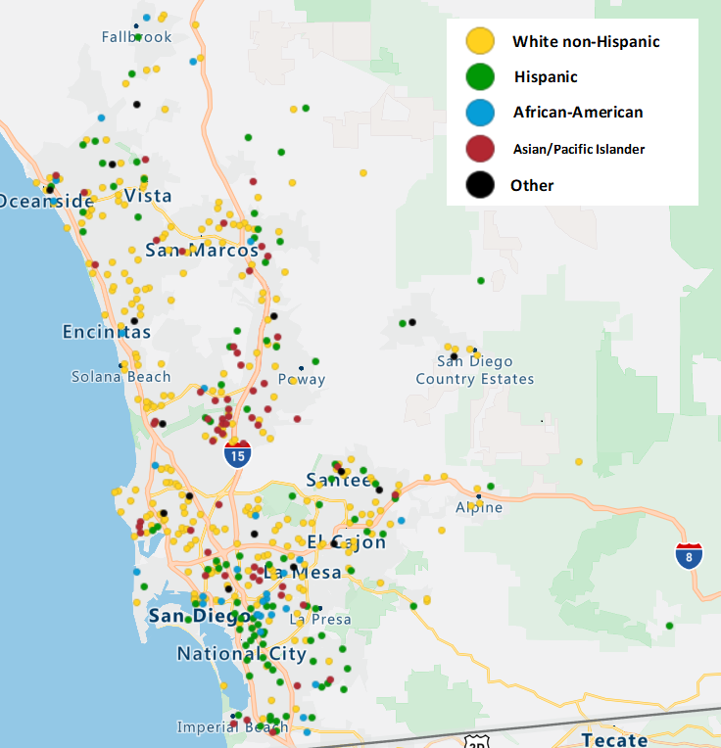
It’s a Big, Diverse County
White non-Hispanic residents are more numerous north of I-8
Hispanics more often reside south of the 8 and south of SR-94
African American residents are also south of the 8
Asian residents cluster along the I-15 corridor, more so in northern San Diego.

Slide 5
Trends

Slide 6
The County’s Mood is Hazy and Tentative
35% say things are going well, but very few are enthusiastic
That’s balanced by the residents who the county is on the wrong track
More residents are describing things as “mixed”
Mood is mainly a political thing
Democrats avoided the “red wave” so remain the most upbeat
Republicans remain very upset
Nonpartisans, minor party voters, and non-registrants living between SR-54 and SR-94 are agitated
Much more so than their counterparts elsewhere
Suggests a niche problem here among non-Democrats.

Slide 7

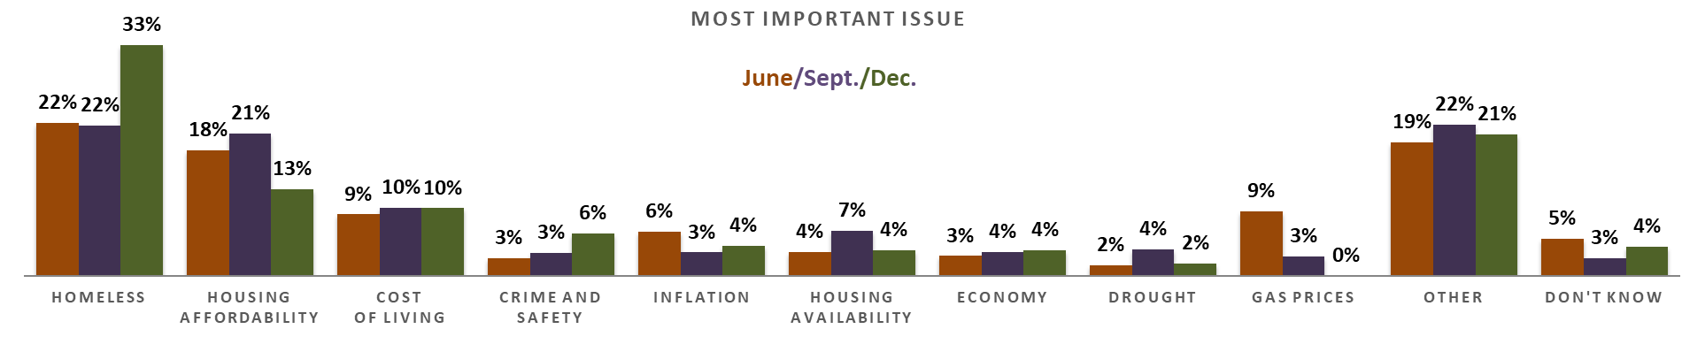
Homelessness Far Outpaces Other Concerns
Top issue for 33% – huge for an open-ended question -- and up from September
Is that a seasonal effect?
Out-performs economic issues
Big focus in La Mesa, Allied Gardens, Tierrasanta, SDSU area, and unincorporated communities
The attention on housing affordability has cooled
But those north of SR-78 are twice as sensitive about it
Cost of living is at 10% and also a bigger concern in the county’s northern reaches
Crime has become more important
Housing availability is at 4%
Gas prices have fallen off residents’ radar.

Slide 8
Mood and Issues Among Communities of Color
Opinions of the County’s direction among the AAPI, Black, and Latino communities are comparable to those of Whites
All ethnic communities regard homelessness as a top issue
AAPI residents emphasize housing availability more often
African Americans are more apt to see the cost of living as the most important issue
Crime is more top-of-mind for Latinos, while housing availability is less so.

Slide 9
The Cost of Living

Slide 10
San Diego is World’s 17th Most Expensive City
As ranked by the Economist Intelligence Unit's 2022 Worldwide Cost of Living (WCOL) survey
The cost of living in America’s Finest City is rising shockingly fast
San Diego rose 33 spots in the list
Ranked 50th in 2021.

Slide 11
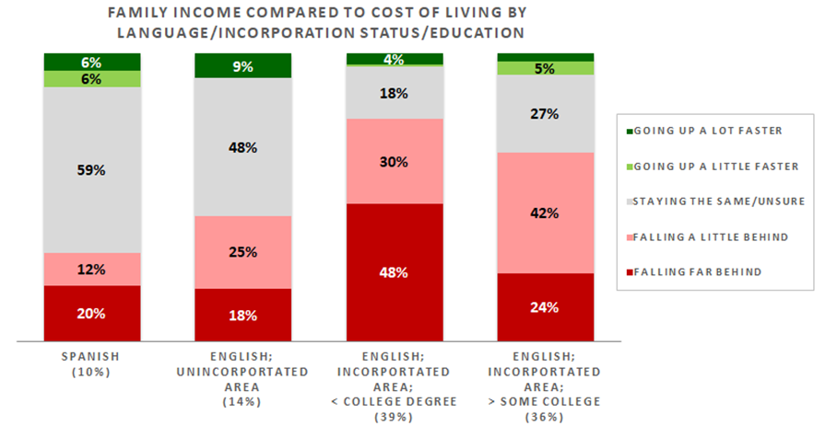
Almost 2/3 Say Their Income is Falling Behind
And a large 32% say it’s falling far behind
That’s > 800,000 residents
28% believe their income is about even with the CoL
Only 7% say their income is rising faster than living expenses
FAMILY INCOME COMPARED TO COST OF living
Spanish-speakers are the most comfortable
Urban residents who took our survey in English are falling behind more often
Dread is heaviest among less-educated
Those w/o a college degree are falling far behind 2x as often
But even most urban English-speakers with a college or advanced degree feel the pain.

Slide 12
A Closer Look at Our Ethnic Communities
More Black households are falling far behind the cost of living
AAPI households are doing better at keeping pace with rising costs
Latino residents report no differences.
 |  | White | Latino | Black | Asian | All
Family income compared to cost of living | Falling far behind | 30% | 31% | 50% | 24% | 32%
 | Falling a little behind | 30% | 27% | 21% | 34% | 32%
 | Staying the same/Unsure | 34% | 35% | 19% | 37% | 30%
 | Going up a little faster | 2% | 4% | 6% | 2% | 3%
 | Going up a lot faster | 4% | 2% | 3% | 3% | 4%

Slide 13
Predictions for San Diego’s Cost of Living

Slide 14
Residents Agree Costs are Not Likely to Slow
82% think the CoL will be higher a year from now
42% say a lot higher
Only 6% predict it will be lower
COST OF living a year from now
Every demographic thinks costs will rise
Education and personal experience dictate how much residents believe costs will rise
80% of who never attended college and who are falling far behind think things will get a lot worse
Their college graduate counterparts expect a less drastic increase
Non-Whites falling behind “a little” forecast a more dramatic increase than Whites do
Even those not falling behind predict CoL will rise.

Slide 15
A Closer Look at Our Ethnic Communities
Predictions among Black and AAPI San Diegans align with those of other residents
88% of Latinos think the cost of living will be higher a year from now
54% say a lot higher
They are much more negative about the cost of living in San Diego.
 |  | White | Latino | Black | Asian | All
Cost of living a year from now | A lot higher | 36% | 54% | 52% | 43% | 42%
 | A little higher | 44% | 34% | 30% | 41% | 40%
 | About the same/Unsure | 13% | 10% | 13% | 14% | 12%
 | A little lower | 6% | 2% | 5% | 2% | 6%
 | A lot lower | 0% | 0% | 0% | 0% | 0%

Slide 16
Are the Prices of Everyday Items Causing Financial Hardship?

Slide 17
Nearly 2/3 Have Faced Recent Hardship
29% have endured either serious or extreme problems
Those facing extreme pressures equates to tremendous suffering among > 330,000 residents
HAVE PRICES CAUSED HARDSHIP THIS MONTH
Residents living between SR-54 and SR-94 – remember them? -- are being hit hardest
Only 19% have not experienced privation
1/3 face extreme hardship
Non-Whites elsewhere encounter hardship more than the average resident
White women elsewhere are also are 3x as likely as White men to have dealt with extreme problems
Overall, though, 38% report no hardship and another 34% report only some anxiety.

Slide 18
A Closer Look at Our Ethnic Communities
Hardship experienced by AAPI and Black residents is comparable to the wider population
Though more Blacks experience more extreme problems
Latinos report facing more hardship.
 |  | White | Latino | Black | Asian | All
Have prices caused hardship this month? | Extreme hardship | 11% | 18% | 28% | 12% | 13%
 | Serious hardship | 15% | 12% | 8% | 16% | 16%
 | Some hardship | 34% | 37% | 26% | 25% | 34%
 | No hardship | 41% | 33% | 37% | 46% | 38%

Slide 19
What Would San Diegans Cut Back On?

Slide 20
Cutting Expenses is a Reality for Many
31% would axe eating out or entertainment
Often chosen by highly educated residents who aren’t falling behind
1-in-10 would cut back on food or groceries
What those experiencing extreme or serious hardship choose, particularly if they also haven’t attended college
No choice but to cuts the essentials
10% would limit travel and vacations
Those facing some or no hardship often give this answer
6% would decrease their unnecessary or discretionary spending
Frequent pick of multi-racial residents
22% wouldn’t cut back on anything
Tend to be those who avoided hardship…
Nothing they need to cut back on
Or those dealing with extreme hardship
They’ve already cut back in every possible area
HHs in the middle will find something to cut.

Slide 21
A Closer Look at Our Ethnic Communities
Members of the ethnic communities would generally cut the same things in order to make ends meet.
 |  | White | Latino | Black | Asian | All
Main thing to cut back on | Eating out/ Entertainment | 31% | 28% | 31% | 38% | 31%
 | Food and groceries | 11% | 10% | 10% | 8% | 10%
 | Travel/Vacations | 12% | 13% | 9% | 5% | 10%
 | Unnecessary/ Discretionary spending | 4% | 3% | 1% | 2% | 6%
 | Cable/ Subscription services | 4% | 8% | 5% | 4% | 4%
 | Utilities | 4% | 3% | 6% | 5% | 4%
 | Gas | 2% | 4% | 0% | 3% | 2%
 | Housing and rental costs | 2% | 1% | 11% | 3% | 2%
 | Healthcare | 0% | 0% | 2% | 1% | 0%
 | Other | 4% | 10% | 5% | 2% | 5%
 | Nothing | 24% | 16% | 16% | 26% | 22%
 | Unsure | 2% | 4% | 4% | 3% | 2%

Slide 22
The Inflation Reduction Act

Slide 23
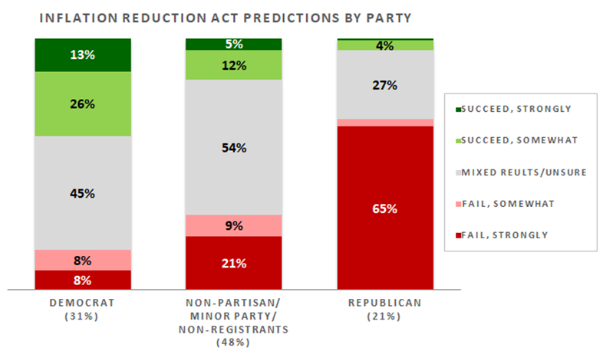
6-in-10 Residents Have Doubts
1/3 think the Act will fail and 26% strongly believe this
27% predict it will only produce mixed results and 19% are unsure what it will do
Just 22% think the legislation will succeed
INFLATION REDUCTION ACT Predictions
GOP voters dismiss the IRA
But even few Democrats are convinced it will work
Those experiencing hardship are a bit more hopeful, but with weak optimism
The Act struggles among those who think the cost of living is the most important issue
Residents who are falling behind are also skeptics
IRA has no traction among those it promises to help most.

Slide 24
A Closer Look at Our Ethnic Communities
African Americans are less negative about the Act than any other racial/ethnic group
They express more mixed views or uncertainty about it
Asians are more negative than Blacks
But they are less positive about the IRA than others
 |  | White | Latino | Black | Asian | All
Inflation Reduction Act perceptions | Fail, strongly | 28% | 21% | 7% | 19% | 26%
 | Fail, somewhat | 5% | 7% | 4% | 2% | 7%
 | Mixed results/Unsure | 41% | 43% | 66% | 68% | 46%
 | Succeed, somewhat | 18% | 18% | 17% | 6% | 14%
 | Succeed, strongly | 8% | 10% | 6% | 5% | 6%
Two-thirds express mixed or uncertain views
Opinions among the AAPI and Latino communities reflect those of all San Diegans.

Slide 25
Thank You!

Slide 26
Public Opinion · Public Policy · Organizations · Campaigns
1987 – Founded in San Diego
1988 – Phonecenters established in Riverside, CA and San Diego
1990 – Phonecenters established in Reno, NV and San Diego
1992 – Predictive dialing installed to double interviewing capacity; CERC calls San Diego Mayor’s race
1993 – "The Edge" newsletter launches
1998 – Qualitative focus groups introduced
2000 – CERC calls San Diego Mayor’s race
2003 – KPBS/Competitive Edge Research Poll and annual Super Bowl poll launched
2004 – CERC calls San Diego Mayor’s race (x2)
2005 – CERC calls San Diego Mayor’s race (x2)
2006 – SDIPR/CERC Opinion Barometer launched; Ballot measures paper presented at AAPOR Conference
2008 – CERC calls San Diego Mayor’s race; Convenes post-election summit @ USD
2009 – Interviewer effects paper presented at AAPOR Conference
2010 – Web-based interviewing and custom panels introduced
2012 – Dial-testing introduced; CERC calls San Diego Mayor’s race (x2)
2013 – CERC calls San Diego Mayor’s race; Business Forecast survey launched
2014 – CERC calls San Diego Mayor’s race
2016 – CERC calls San Diego Mayor’s race
2017 – Phonecenter established in El Paso, TX
2018 – CERC calls CA Governor’s race (x2)
2019 – Ballot measure wording paper presented at AAPOR Conference
2020 – Incumbent viability paper accepted for presentation at AAPOR Conference
2022 – San Diego County Issues Barometer launched
John Nienstedt, MA Political Science: President
Member, American Association for Public Opinion Research
SBA Entrepreneurial Success Award (2000)
Pollster of the year (x7)
Rachel Lawler, MA Political Science: Research Analyst
Member, American Association for Public Opinion Research
Ronald Zavala: Director of Operations
James Iwu: Research Assistant

